Slide 1
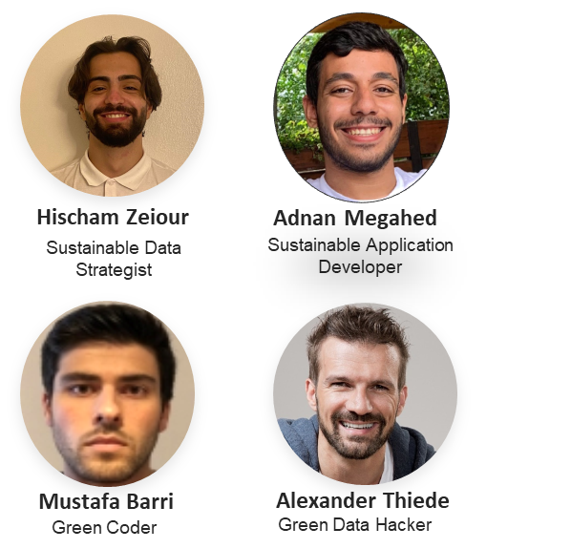

Climate Action Plan
Open Source for Sustainability

Slide 2
Climate Action Plan
Navigating Stakeholder Expectations: The Comprehensive CAP Report

Slide 3
The Significance of the Paris Agreement and CSRD Guidelines for Businesses
Adapting to global climate goals: Difficulties in integrating the Paris Agreement targets into corporate strategy
Emissions reduction: Obstacles in identifying and implementing effective measures to reduce CO2 emissions
Sustainable business practices: Challenges in integrating environmental, social, and governance factors into daily operations and decision-making
Complying with CSRD guidelines: Complexity of new reporting obligations and changing regulatory requirements
Stakeholder expectations: Difficulties in transparent communication and reporting on sustainability measures to build trust and credibility
Resource management: Issues in efficiently using and conserving natural resources in the supply chain and production processes

Slide 4
Challenges
Uncoordinated and unstructured environmental initiatives
Absence of specific, measurable sustainability targets
Ineffective stakeholder communication on climate action progress
Inefficient resource utilization, leading to higher costs and environmental impacts
Inability to adapt to changing regulations and climate goals
Lack of competitive advantage as a responsible and environmentally-conscious organization

Slide 5
Action Plan Overview – Goals and Measures
Definition:
A comprehensive roadmap to reduce greenhouse gas emissions, adapt to climate change impacts, and transition to a low-carbon economy.
Objectives:
Mitigation: Lower emissions from energy, transportation, industry, and more.
b) Adaptation: Enhance resilience to climate impacts (e.g., extreme weather, sea-level rise).
c) Sustainable Development: Promote eco-friendly practices and technologies.
Key Measures:
Emission Reduction Targets: Set clear, measurable, and time-bound targets for lowering emissions.
Energy Efficiency: Improve efficiency in buildings, appliances, and transportation.
Renewable Energy: Expand the use of solar, wind, and geothermal power. d) Sustainable Transportation: Encourage public transit, cycling, and electric vehicles.
Waste Management: Reduce waste, increase recycling, and promote composting.
Public Awareness and Participation: Educate communities and involve stakeholders in climate action efforts.

Slide 6
Introduction to the Climate Action Plan
What is a Climate Action Plan?
A Climate Action Plan (CAP) is a comprehensive roadmap that outlines specific actions an organization will undertake to reduce greenhouse gas (GHG) emissions.
CAPs are based on detailed emission inventories which allow organizations to identify where their emissions come from and develop tailored strategies to reduce them
Key Components of a CAP
Emission Inventory: A detailed breakdown of an organization's GHG emissions.
Emission Reduction Targets: Specific, measurable goals for reducing GHG emissions.
Action Items: Concrete steps the organization will take to meet its targets.
Monitoring & Reporting: Regular evaluation of the plan's progress and adjustments as needed.

Slide 7
Understanding Scope 1, 2, and 3 in the Climate Action Plan
Scope 1 - Direct Greenhouse Gas Emissions
Emissions from sources that are owned or controlled by the organization.
Scope 2 - Indirect Greenhouse Gas Emissions
Emissions from the generation of purchased or acquired electricity, steam, heat, or cooling consumed by the organization.
Scope 3 - Other Indirect Greenhouse Gas Emissions
All other indirect emissions that occur as a consequence of the activities of the organization, but from sources not owned or controlled by the organization.

Slide 8
Levers in the Climate Action Plan
Energy Efficiency (Scope 1 & 2 Levers)
Implement energy-saving technologies and practices across our operations
Renewable Energy (Scope 2 Levers)
Transition to renewable sources for electricity needs
Transportation and Logistics (Scope 1 & 3 Levers)
Optimize transport routes and adopt low-carbon transport modes
Waste Management (Scope 1 & 3 Levers)
Reduce waste and promote recycling and composting
Supply Chain Management (Scope 3 Levers)
Encourage and work with suppliers to reduce their emissions
Employee Engagement (Scope 1, 2 & 3 Levers)
Educate and engage employees in sustainable practices

Slide 9


Personas
Challenge
Wish
High pressure to reach corporate climate goals
Needs to align with and steer carbon emissions across business divisions (according to CAP)
provide transparency on current numbers to the board and customers
Visualize progress on overall climate goals and Contoso levers
Sarina Mueller
Head of Sustainability
Needs to build and implement a roadmap to reduce carbon emissions for his business responsibility (according to CAP, but under consideration of margin)
Therefore, needs to know the most impactful measures.
Visualize impact at business division level and gain actionable insights how to reduce gap to CAP aligned with Contoso levers.
Claus Kampel
BU / Business Field Responsible

Slide 10
Corporate Perspective
"As a Sustainability Manager for Contoso the EU, the role is multifaceted and complex. It requires processing and interpreting vast amounts of incoming data. In addition, there's increasing pressure from stakeholders to achieve carbon neutrality, which further adds to the complexity of the task. On top of this, there's the challenge of effectively communicating our sustainability efforts”

Slide 11
Unlocking Climate Action and Sustainability Success
Strategic Framework: CAP Reports offer a structured approach for prioritizing and organizing environmental initiatives.
Measurable Goals: CAP Reports set specific, quantifiable sustainability targets, enhancing transparency and accountability.
Stakeholder Communication: CAP Reports enable clear communication of climate action progress to stakeholders, boosting credibility.
Resource Efficiency: CAP Reports help identify conservation, waste reduction, and energy efficiency opportunities, improving performance and cost savings.
Adaptability: CAP Reports allow organizations to adapt to changing regulations and climate goals, ensuring compliance and alignment.
Competitive Advantage: Implementing a CAP Report differentiates companies as responsible, future-oriented, and environmentally-conscious, attracting stakeholders.

Slide 12



Microsoft Plattform
Power Apps:
An environment of apps, services, connectors and data platforms to provide rapid development environments
Create custom business requirements that connect to business data
This connection and all data can be stored in the Microsoft Dataverse data platform
Microsoft Power BI:
A unified and scalable platform for self-service an enterprise BI
Connect to all data and visualize it
Visualizations can be inserted and open in Web, App or Smartphone
Microsoft Sustainability Manager:
Unify data intelligence
Build a sustainable IT infrastructure
Reduce environment impact of operations
Create sustainable value chains
Notes:
In this final slide, let's take a look at the platforms that have been utilized to develop and support our open-source CAP Report solution:
Power Apps: This is an environment of apps, services, connectors, and data platforms that provides rapid development environments. It allows you to create custom business requirements that connect to business data, which can be stored in the Microsoft Dataverse data platform.
Microsoft Power BI: A unified and scalable platform for self-service and enterprise Business Intelligence. Power BI enables you to connect to all your data sources, visualize the information, and easily share the visualizations through web, app, or smartphone.
Microsoft Sustainability Manager: This platform helps unify data intelligence, build a sustainable IT infrastructure, reduce the environmental impact of operations, and create sustainable value chains. It serves as the foundation for managing and analyzing sustainability data in our open-source CAP Report solution.
By leveraging these powerful platforms, our open-source CAP Report solution provides organizations with the tools and insights needed to effectively manage their sustainability efforts and achieve their climate action goals."
And with that, we've come to the end of our presentation. Thank you for your attention, and we're happy to answer any questions you may have.

Slide 13
Benefits of Open-Source Climate Action Plan
Customizability: Open-source CAP Reports can be easily adapted to a company's specific needs and requirements
Collaborative Development: Companies can benefit from the experiences and best practices of the open-source community and share their own insights
Continuous Improvement: Open-source CAP Reports are constantly optimized and expanded through collaborative development
Transparency: Open-source solutions promote transparency and trust by revealing the underlying code and methodology
Sustainable Competitive Advantages: Companies that create and implement an open-source CAP Report can position themselves as responsible, forward-thinking, and cooperative players in the market

Slide 14
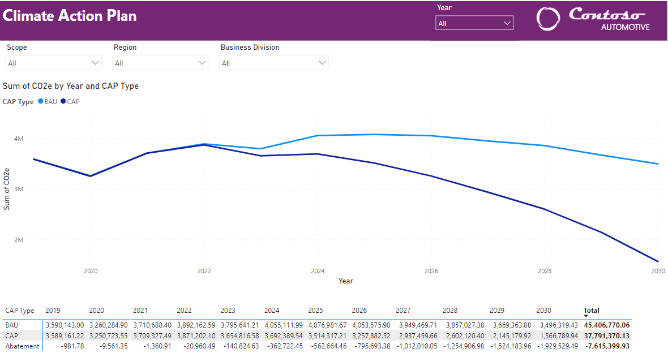
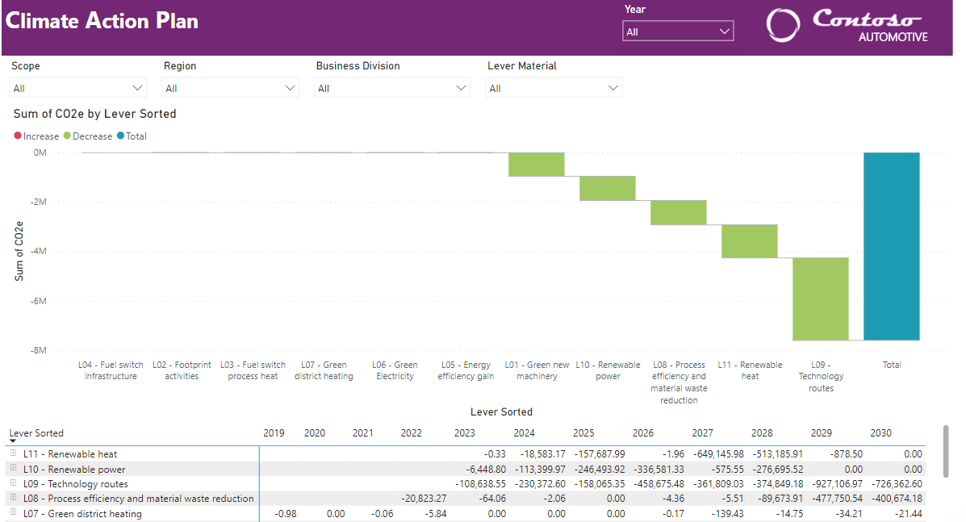
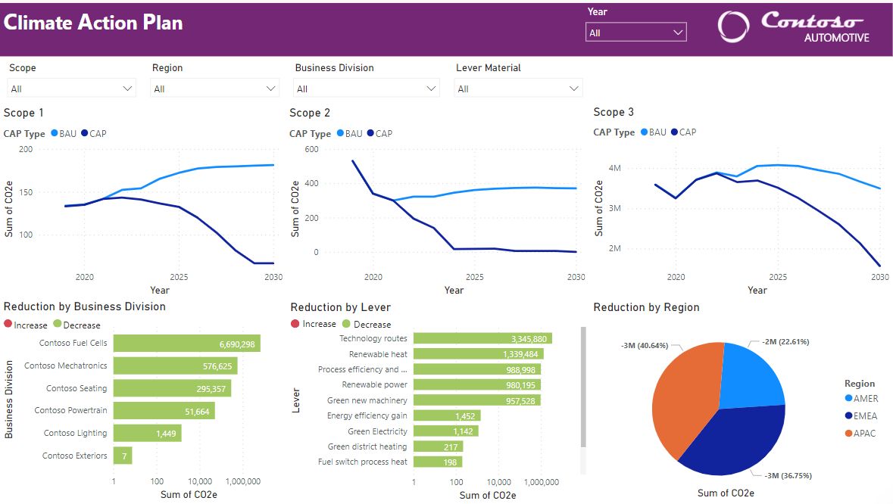


Open-Source Solution
Click on the Icons:

Slide 15
Brainstorming Session
Nominate a speaker for Report out
2. Roundtable Report out 3min (Student Speaker) 11:45
1. How could we motivate people and companies to engage?​
2.What ideas do you have to further extend the sustainability use case?​
3. What could you contribute? ​

